Slide 1

Book recommendations system
Group Members :
Mr. VAMSHI KRISHNA K
Mr. JAY CHANDRAVADAN TRIVEDI
MR.KRISH SANDIPKUMAR MODI
MR.SANGAMESH G SHEELAVANTHMATH
MRS. YOGITA AMIT SHINDE
MS. POOJA DATTATRAY TEMGIRE
MRS. ARATI VINOD SAWANT
MRS. JAZEENA A

Slide 2
Contents
Project Architecture
Introduction to Recommendation System
Data set Details
Data preprocessing and EDA
Visualization
Details about recommendation techniques
Model Evaluation
Deployment
Reference

Slide 3
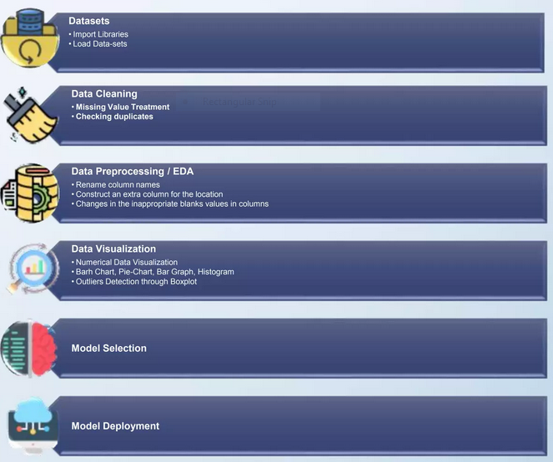
1. Project Architecture

Slide 4

2. Introduction to Recommendation System
Recommendation systems involve predicting user preferences for unseen items.
Recommendation systems have become very popular with the increasing availability of millions of products online
Recommending relevant products increases the customer's interest and sales of the company.
Examples:-
Facebook-" People You May Know“
Netflix-" Other Movies You May Enjoy“
Amazon-" Customers Who brought this item also brought..."

Slide 5
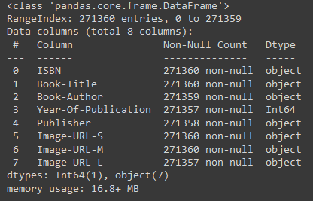
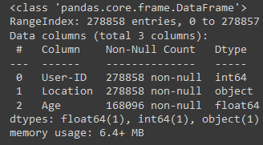
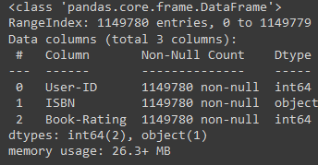
3. Datasets Details
Book Dataset No. of rows : 271360 NO. of columns : 8 | Users Dataset No. of rows : 278858 NO. of columns : 3 | Rating Dataset No. of rows : 1149780 NO. of columns : 3

Slide 6
4. Data preprocessing and EDA
In Books Dataset
Checking of null values and missing data.
Removal of two columns of small image URL and large image URL.
Changing column names for easy recognition.
In the publisher column missing value with others.
In the Year Of Publication column we have two object data DK Publishing Inc replaced this with 2000 and Gallimard replace it with 2003.
In Users Dataset
In the Users Dataset in the Age column we find unique values and with that, we calculate the mean age.
In the Location columns, we have combined information about the city, state, and country we split this information into three different columns.
In ratings Dataset
In this data set we check Book-rating and User-Id are columns that are numerical type.
In the ISBN column we remove extra characters.

Slide 7
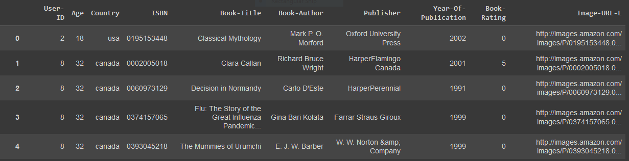
Final Dataset Details
After applying preprocessing on all three dataset. We merge all by using User-ID, ISBN columns and made the final dataset for visualization and model building.
Rows and columns : 50815 and 10
No. of unique user ID : 95513
Null values : zero

Slide 8
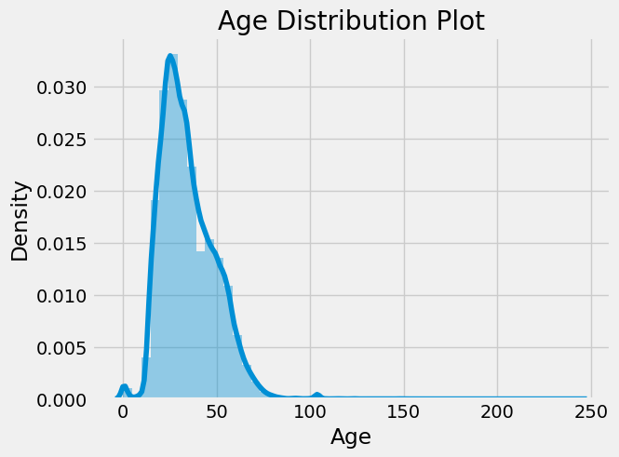
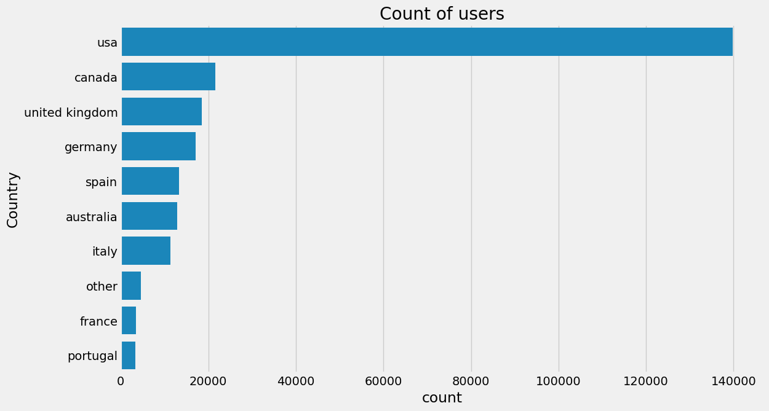
5. Visualization
In distribution plot represent the ages of the users
Count of users in each country

Slide 9
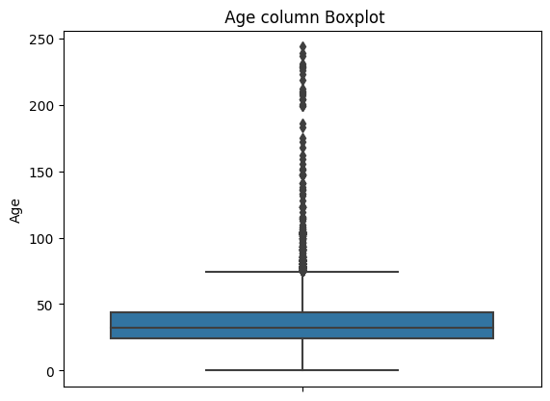
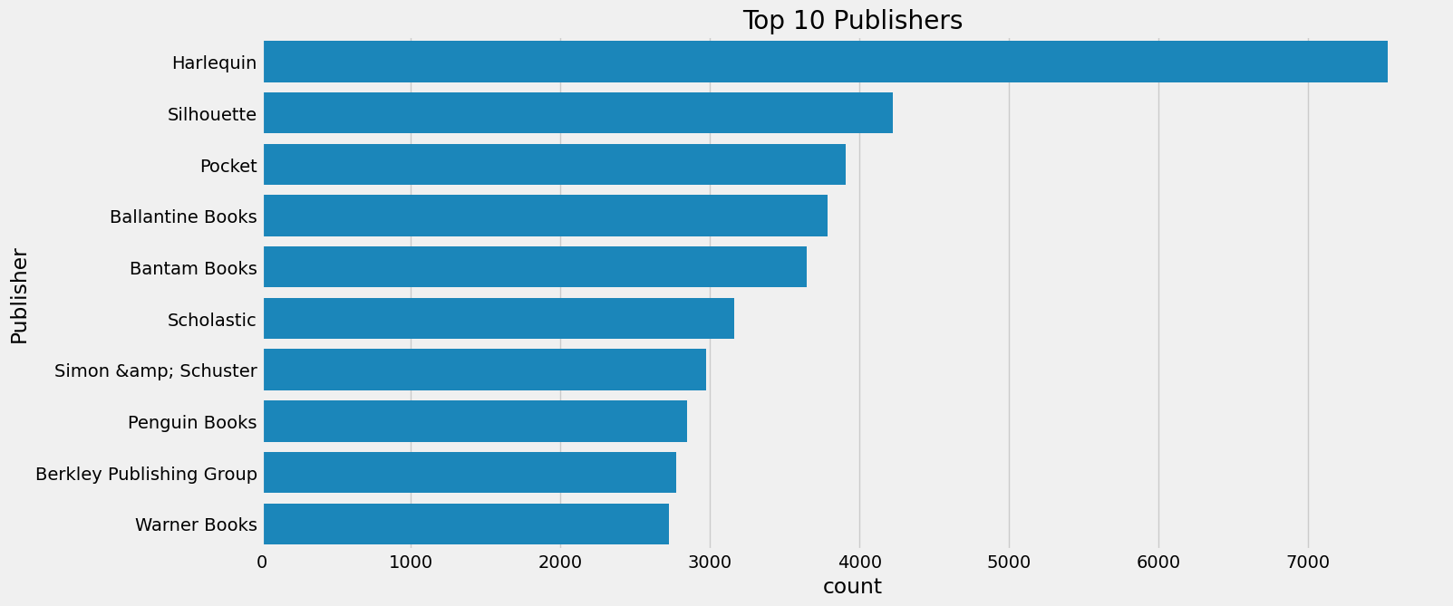
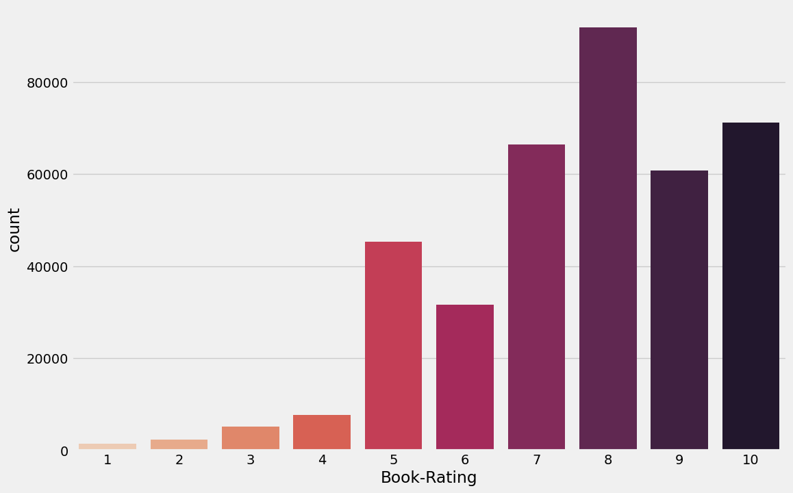
Outliers
There are many outliers in Age columns
Outliers are treated with mean value
Top 10 Publishers
Rating count plot

Slide 10
6. Recommendation Techniques
6.1 Popularity-Based Recommendation system:-
It is a type of recommendation system which works on the principle of popularity and or anything which is in trend. These systems check the product, movies, or books that are in trend or are most popular among the users and directly recommend those.
Advantage of popularity-based recommendation system
There is no need for the user's historical data.
Disadvantage popularity-based recommendation system
The system would recommend the same sort of products/books which are solely based on popularity to every other user.

Slide 11
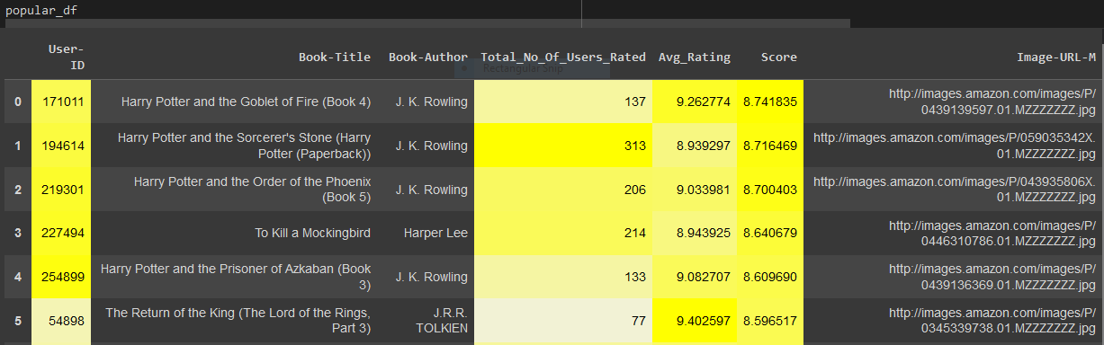
Either following formula used for popularity based recommendation or will show top "20" books from the dataset which has minimum 250 ratings by users
Book weighted avg formula: Weighted Rating(WR)=[vR/(v+m)]+[mC/(v+m)] where,
v is the number of votes for the books;
m is the minimum votes required to be listed in the chart;
R is the average rating of the book; and
C is the mean vote across the whole report.
Now we find the values of v,m,R,C.

Slide 12
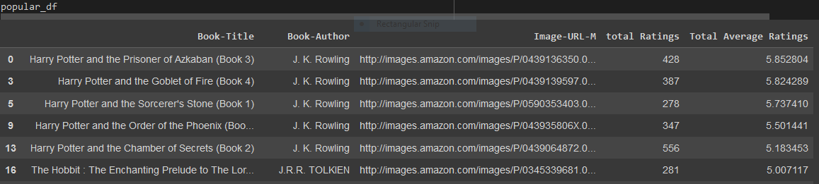
Top "20" books from the dataset which has minimum 250 ratings by users

Slide 13
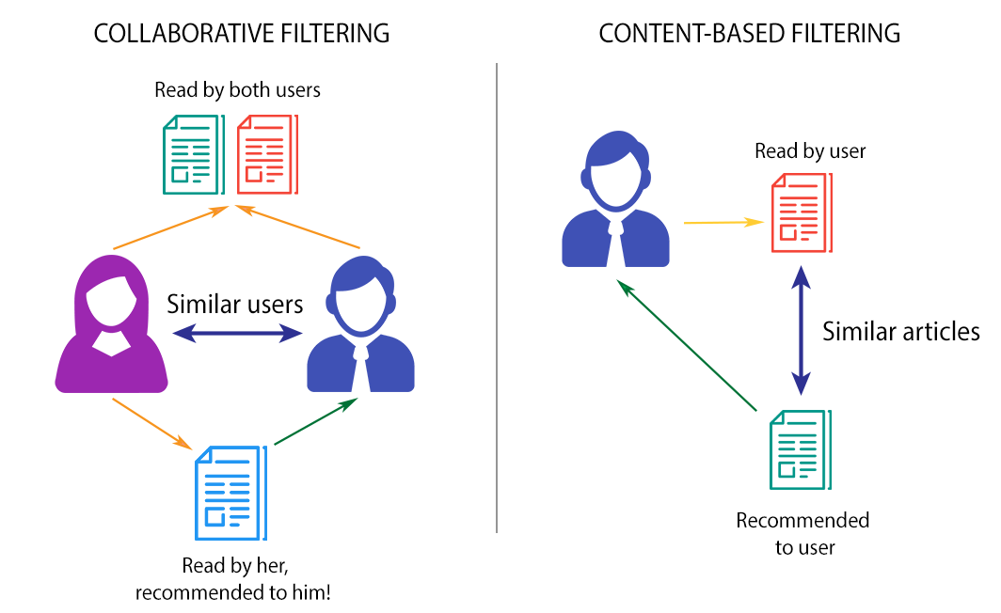
6.2 Collaborative Filtering:-
Collaborative filtering is used by most recommendation systems to find similar patterns or information of the users, this technique can filter out items that users like on the basis of the ratings or reactions by similar users.
Advantage of Collaborative Filtering
Other user scores are used.
No deterministic result since chance is involved in the system
Disadvantage popularity-based recommendation system
Needs more data.
Problem with new users and new products

Slide 14
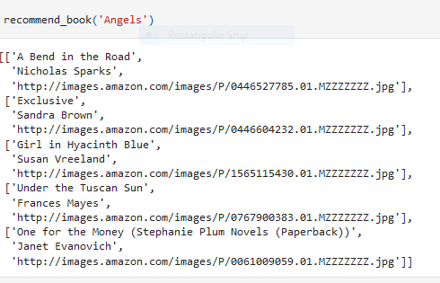
Result of collaborative filtering

Slide 15
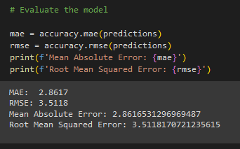
7. Model Evaluation

Slide 16
8. Deployment
﻿Deployment is the process by which a ML model is moved from an offline environment and integrated into an existing production environment, such as a live application. It is a critical step that must be completed in order for a model to serve its intended purpose and solve the challenges it is designed for.

Slide 17

Using Streamlit we have deployed our application

Slide 18
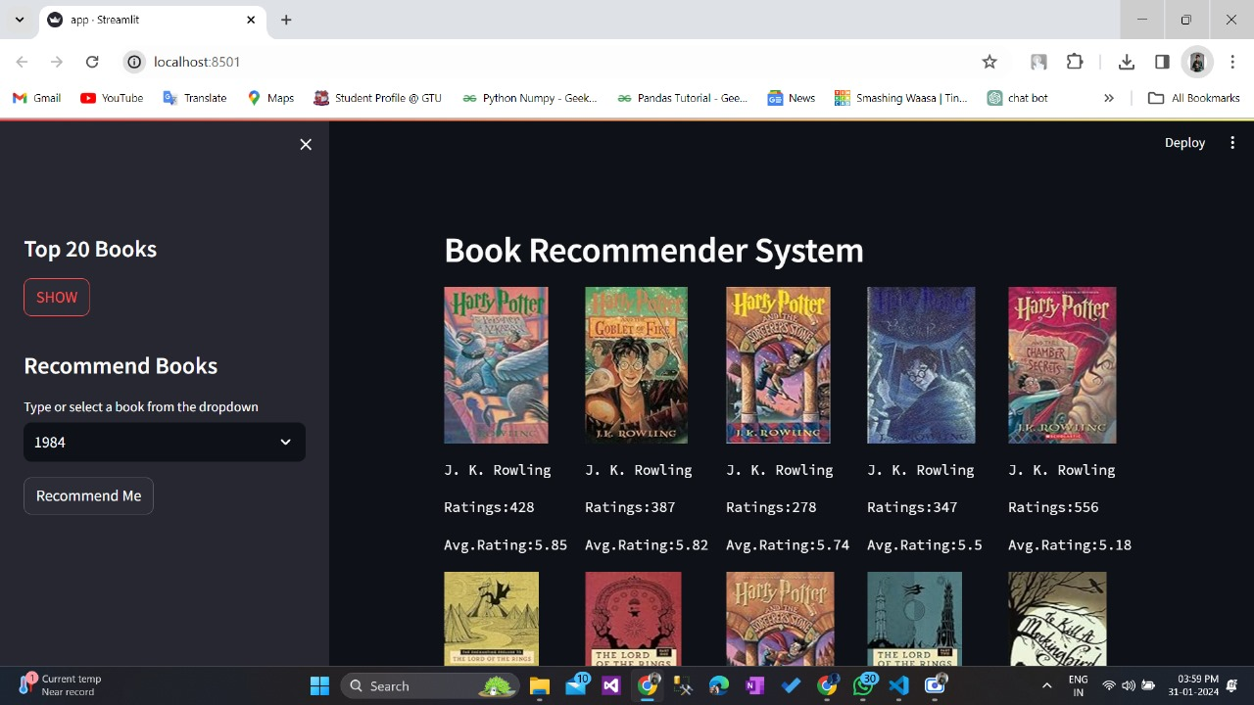

Slide 19
8. Reference
﻿Pandas documentation link:- https://pandas.pydata.org/docs/getting started/index.html
Matplotlib documentation:- https://matplotlib.org/stable/index.html
Streamlit documentation:- https://docs.streamlit.io/library/get-started/main-concepts
Visual studio code :- https://code.visualstudio.com/learn
KNN documentation:- https://scikit-learn.org/stable/modules/generated/sklearn.neighbors.KNeighbors Classifier.html

Slide 20
Thank You

